Slide 1

Unsupervised Learning FIFA 20
Reported By:
Anukriti Sharma
Pranav Naphad
Sairam Akuthota
Maheswara Reddy Nagiri
Amar Hadagali

Slide 2
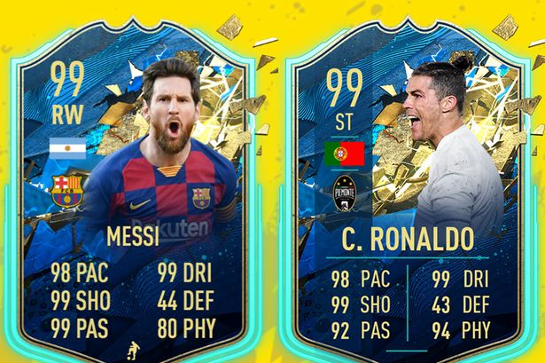
GOAL OF THE PROJECT
We want to build a player recommendation system where you can input your desired player skillsets and our selector will return a list of the top recommended players based on individual skills and not Overall rating in addition to this, we are also trying to achieve the result if the player's name is been input to the system it would recommend the top 10 similar players that can potentially replace the input player
Picking a player, using the easy "Overall" stats, is not the best investment for your game coins. We can dig deeper into the individual player skills and carefully curate the optimal skill combo for each position on the field

Slide 3
Data and Variables
Variable | Data Type | Explanation
overall | Continuous | The overall rating of player given by FIFA
potential | Continuous | The future potential rating of the player
skill_moves | Continuous | The rating of the skill moves shown by the player
pace | Continuous | The pace of the player
shooting | Nominal | The shooting accuracy of the player
passing | Nominal | The passing accuracy of the player
dribbling | Nominal | The dribbling accuracy of the player
defending | Nominal | The defending ability of the player
physic | Continuous | The rating of the physic of the player
Short_name | Nominal | The name of the player
nationality | Nominal | The country for which the player plays
player_positions | Nominal | The position at which the player plays i.e., ST, GK, CDM etc
preferred_foot | Nominal | The preferred foot with which the player shoots the ball.
gk_reflexes | Continuous | The reflex rating of the goalkeeper
gk_handling | Continuous | The ball handling ability of the player
power_shot_power | Continuous | The rating of the power with which the players take a shot
power_stamina | Continuous | The rating of the stamina of the player
gk_speed | Continuous | The rating of the speed of the player
gk_diving | Continuous | The rating of the diving ability of the goalkeeper
gk_positioning | Continuous | The rating of the ability to position of the goalkeeper
The dataset has 18278 observations and 104 variables. The dataset has both numeric and character variables.

Slide 4
Data Preparation
The skillsets of Goalkeepers such as ball handling etc. will be different from that of the Outfield Players so those values will be null for Outfield players.
So, we have divided our data in to two sets.(Goalkeeper Dataset, Outfield Dataset)
There was no Missing value after dividing the data set.
We are using physical attributes, strength, and skillset to find suitable replacement players, we will be filtering the datasets to retain only these variables so that reduces our variable from 104 variable to 20 variable for analysis.
We use the scale() function to basically normalize the datasets.

Slide 5
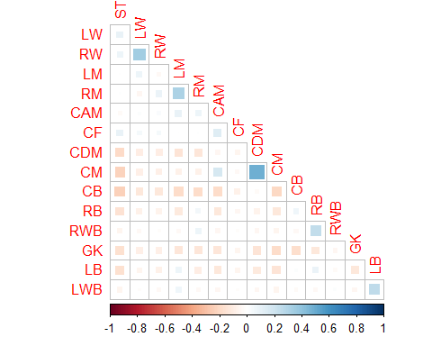
Correlation
Sometimes same player takes over several positions, sometimes only one like a goalkeeper
Mid center players often share position of a center defending midfielder. Left and right back wingers clearly have positive correlation so as right and left mid-siders.

Slide 6
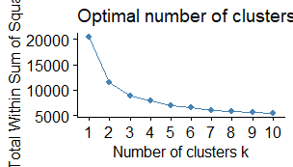
K-Means Clustering
The elbow method uses the sum of squared distance (SSE) to choose an ideal value of k based on the distance between the data points and their assigned clusters.
the elbow of the arm is the optimal number of clusters, which is 3 in our case

Slide 7
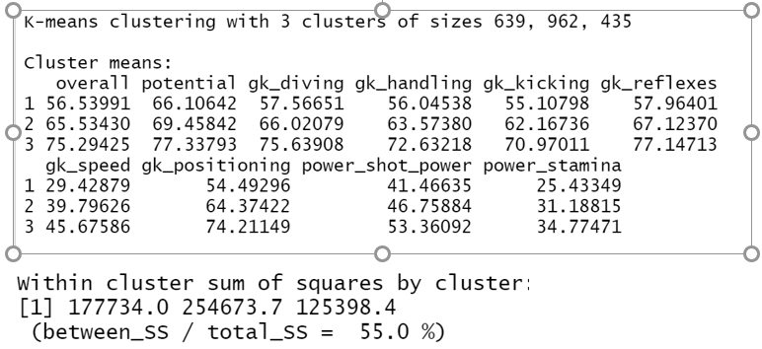
Goal-Keeper Dataset
We have used KMEANS function to get the cluster means observation of all the data.
So we can predict this in a way that if the player is having a high skill or if we want a player to have a high skillset then we can choose the player from cluster 3. If the skillset is mediocre then the player from cluster 2 should be selected and same with cluster 1.

Slide 8
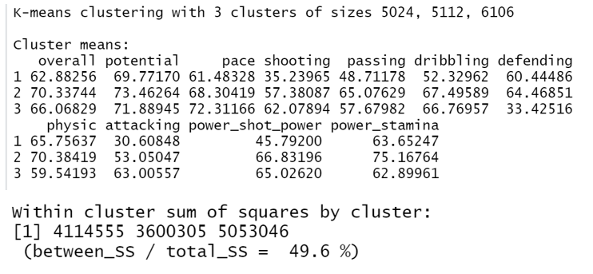
Outfield Players
So we can predict this in a way that if the player is having a high skill or if we want a player to have a high skillset then we can choose the player from cluster 2. If the skillset is mediocre then the player from cluster 3 should be selected and same with cluster 1.

Slide 9
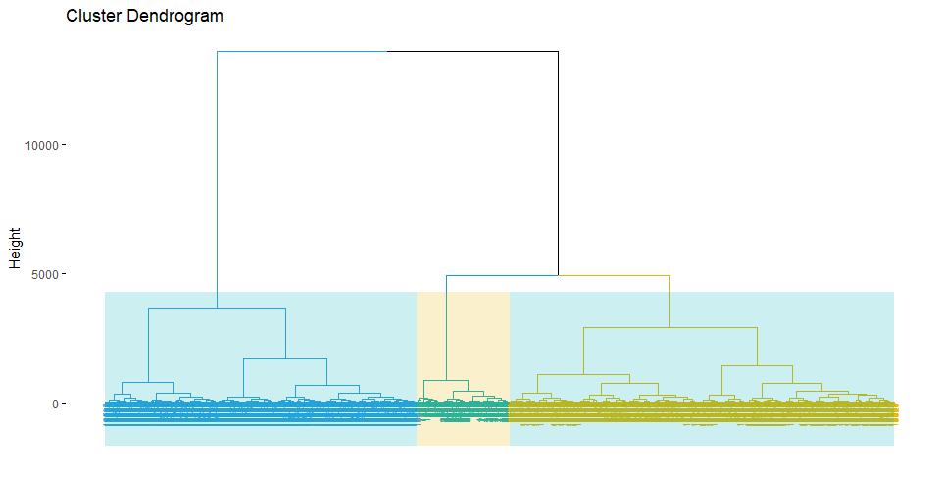
Hierarchical Clustering
We have taken Euclidean distance and used HCLUST function and WARD method to make the cluster.
This is a “top-down” approach: all observations start in one cluster, and splits are performed recursively as one moves down the hierarchy

Slide 10
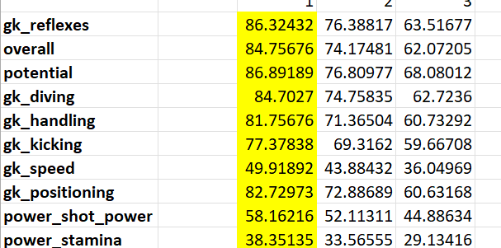
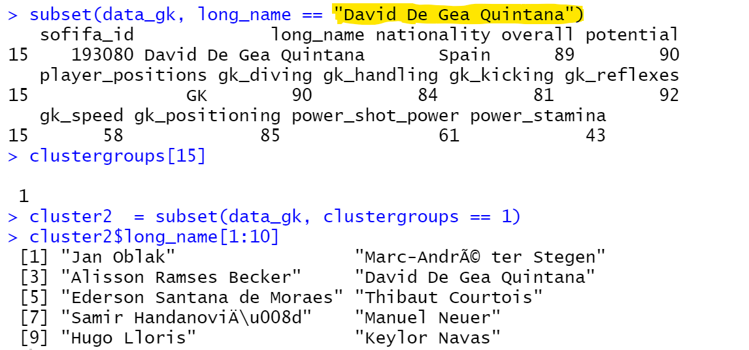
Goalkeepers
We have used Tapply for each skillset after cluster and got the cluster means regarding the same
Similar player skillset predict for the David De Gea Quintana

Slide 11
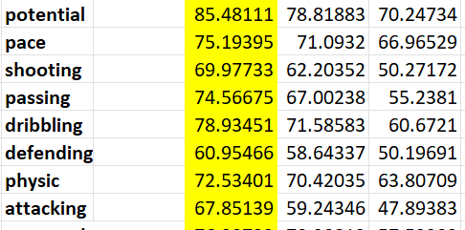
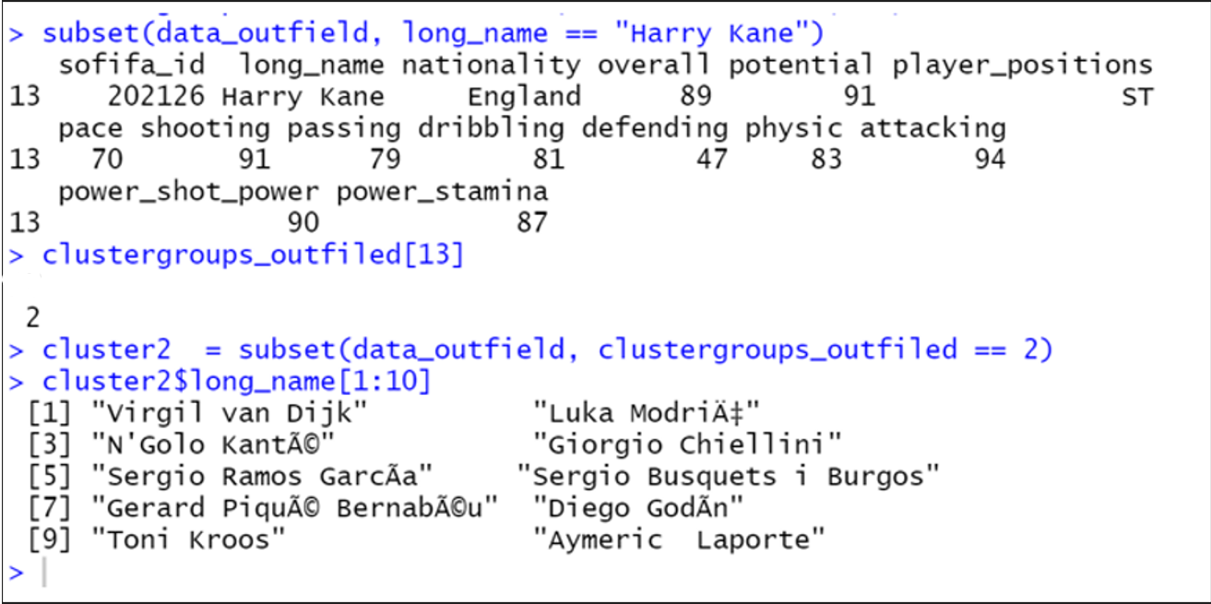
Outfield Players
Similarly, we can check player replacements for the outfield players as well, here we are checking a possible replacement for the outfield Player Harry Kane.

Slide 12
Comparison
Validation Measures | K- Means | Hierarchical
Average.between | 4.683511 | 5.152349
Average.within | 3.332567 | 3.366592
dunn | 0.2756118 | 0.3117369
entropy | 1.093083 | 0.7933862
The Dunn Index (DI) :A higher DI implies better clustering. It assumes that better clustering means that clusters are compact and well-separated from other clusters
Entropy: The lower entropy means better clustering. The greater entropy means that the clustering is not good. The quantity of disorder is found by using entropy

Slide 13
Conclusion
A higher value of Dunn indicates the better clustering Entropy is a native measure; the lowest entropy is the best clustering, the values indicated above show that hierarchical has a high value of the Dunn index and a low value of entropy.
This indicates a good clustering.. The hierarchical algorithm is more compliant for FIFA data sets than the K-means.

Slide 14
Thank-you

